Slide 1
National Diabetes Experience Survey 2024
Communications Toolkit

Slide 2
CONTENTS
1 | About this toolkit
2 | About the National Diabetes Experience Survey
3 | Survey aims and questionnaire
4 | Key messages
5 | Poster
6 | Website copy
7 | Newsletter copy
8 | Blog copy
9 | Advisory Group quotes
10 | Social media content (X, Instagram, LinkedIn, Facebook)
11 | Videos
12 | NHS England blog
13 | Icons
14 | FAQs

Slide 3
ABOUT THIS TOOLKIT
What is this toolkit?
This toolkit is designed to help promote and guide communications about the 2024 National Diabetes Experience Survey. Please use this toolkit to help raise awareness of the survey and encourage people living with diabetes to take part. We have developed this content to be suitable for the NHS as well as other organisations and charities to use.
The materials used in this toolkit are available to download at www.diabetessurvey.co.uk/promote-the-survey.
Why is it important to promote the survey?
From 18th March 2024, over 100,000 adults living with type 1 or type 2 diabetes in England will be invited to take part in the survey. They will be contacted directly by letter and text message (if a mobile number is available for them). Three letters will be sent out around 18th March, 10th April and 2nd May. SMSs will be sent out around 25th March, 18th April and 9th May.
Additional promotion of the survey can help encourage people to take part. It is important that as many people as possible respond to the survey so that the results reflect the views of different people living with diabetes.
The results of the survey will provide data at national and local (Integrated Care System) level for your diabetes population. The more people who take part, the better the quality of information we will receive about people’s experiences of diabetes care at a national and local level.
How should the toolkit be used?
People living with diabetes will be chosen at random to take part in the survey, using a sampling strategy that ensures a representative demographic mix of people living with type 1 and type 2 diabetes in England. Not everyone living with diabetes will be invited to take part.
Please do not contact people living with diabetes directly to promote the survey (for example, directly sending text messages or emails). This would introduce an inconsistency in the communications approach across areas and may lead to a bias in the survey results.
We recommend using the messaging in this toolkit as it has been developed to focus on the key messages to communicate with the audience for this survey. Please make sure you do not change the core messaging or any quotes from the Advisory Group members.
This toolkit focuses on encouraging participation in the survey from those who have been selected to take part. Guidance on analysing and sharing the results of the survey will be available in Autumn 2024.
If you have any questions about the toolkit, please contact NHS England (england.digitaldiabetes@nhs.net) or Ipsos (diabetessurvey@ipsos.com).

Slide 4
ABOUT THE SURVEY
This summary can be used to describe the National Diabetes Experience Survey and its purpose. Below is a short and longer version depending on the content or channel you are applying it to.
Short summary:
The National Diabetes Experience Survey is the first NHS survey of its kind. It gives people living with type 1 or type 2 diabetes in England the opportunity to feedback on their experiences. People who are randomly selected will be invited to take part from March 2024. NHS England will use the findings to understand and improve experiences of NHS care and self-management for people living with diabetes. This important survey was developed together with people living with diabetes. For more information please visit www.diabetessurvey.co.uk.
Longer summary:
The National Diabetes Experience Survey is the first NHS survey of its kind. Until now, there has not been a national survey of this scale among people living with diabetes. This is an exciting new opportunity to have your voice heard.
The National Diabetes Experience Survey gives people living with type 1 or type 2 diabetes in England the opportunity to feedback on their experiences. People who are randomly selected will be invited to take part from March 2024. This important survey was developed together with people living with diabetes.
If you are invited, please take part to help the NHS to understand what it is like to live with diabetes in England today. Your voice can make a difference in shaping future NHS diabetes care in England. We need as many people as possible to respond to the invite so that the results reflect the views of different people living with diabetes. We want to make sure that your views are represented. Whoever you are, whichever services you access, and whatever your experiences of living with diabetes, your opinion is important to us.
NHS England will use the findings to understand and improve experiences of NHS care and self-management for people living with diabetes. The results will be available in Autumn 2024 at national and local level. For more information, please visit www.diabetessurvey.co.uk.

Slide 5
SURVEY AIMS & QUESTIONNAIRE
The National Diabetes Experience Survey asks people living with type 1 or type 2 diabetes about their experiences of care or self-management. This slide lists the topics included in the questionnaire. From 18th March, the full questionnaire will be available to view at www.diabetessurvey.co.uk.
Aims:
The survey aims to measure experiences of diabetes care and self-management.
Data will be published at national-level and for each Integrated Care System.
It will be possible to analyse the data by different demographic groups and type of diabetes to understand inequalities in experiences.
Questionnaire content:
Experience of diagnosis, including what led to diagnosis, any delays experienced, information provided, and conversation with a healthcare professional about next steps.
Last NHS annual review for diabetes, including which checks were carried out and whether results were discussed with a healthcare professional, experience of interactions with healthcare professionals, and barriers to having an annual review.
Last NHS appointment, including which NHS service and healthcare professional this was with, and experience of interaction with healthcare professional.
Diabetes courses, including whether a diabetes course has been completed, whether it was offered by a healthcare professional, and barriers to taking part in a diabetes course.
Living with diabetes, including the impact on the individual’s life, acceptance of living with diabetes, confidence in managing diabetes, support from healthcare professionals, information provided by healthcare professionals on medicine and complications, and barriers to managing diabetes.
Using devices to manage diabetes, including whether any devices are used, confidence in using devices, and barriers to using devices.
Demographics

Slide 6
KEY MESSAGES
Below are the key messages to use when communicating about and promoting the National Diabetes Experience Survey. We recommend using the primary messages in shorter form content and the secondary key messages in longer form content.
Primary key messages:
NHS England wants to understand the needs of people living with type 1 or type 2 diabetes and how they experience diabetes care in England.
The National Diabetes Experience Survey is designed to help diabetes services in England make improvements based on what really matters to people living with diabetes.
If you are invited, please don’t miss your opportunity to take part and make your voice heard. We need as many people as possible to respond to the invite so that the results reflect the views of different people living with diabetes.
The National Diabetes Experience Survey is the first NHS survey of its kind. Until now, there has not been a national survey of this scale among people living with diabetes. This is an exciting new opportunity to have your voice heard.
Secondary key messages:
The National Diabetes Experience Survey asks people living with type 1 or type 2 diabetes to feedback on their experience of care and management of diabetes to NHS England.
Diabetes services can use the results of the National Diabetes Experience Survey to understand the needs of people living with diabetes in England today, their experience of diabetes care, and the health inequalities for people living with diabetes. The survey has been designed to help diabetes services make improvements based on what really matters to people. NHS England will also use the findings to understand and improve experience of NHS care for people living with diabetes.
NHS England has collaborated closely with people living with type 1 and type 2 diabetes, carers of those living with diabetes, healthcare professionals, and local providers to develop this survey. We also spoke to around 150 people living with diabetes as part of a qualitative research study. This collaborative approach means we have developed a survey which reflects what matters most to people living with diabetes.
The National Diabetes Experience Survey is the first NHS survey of its kind. Until now, there has not been a national survey of this scale for people living with diabetes in England. This is an exciting new opportunity to help diabetes services make improvements based on what really matters to people.

Slide 7

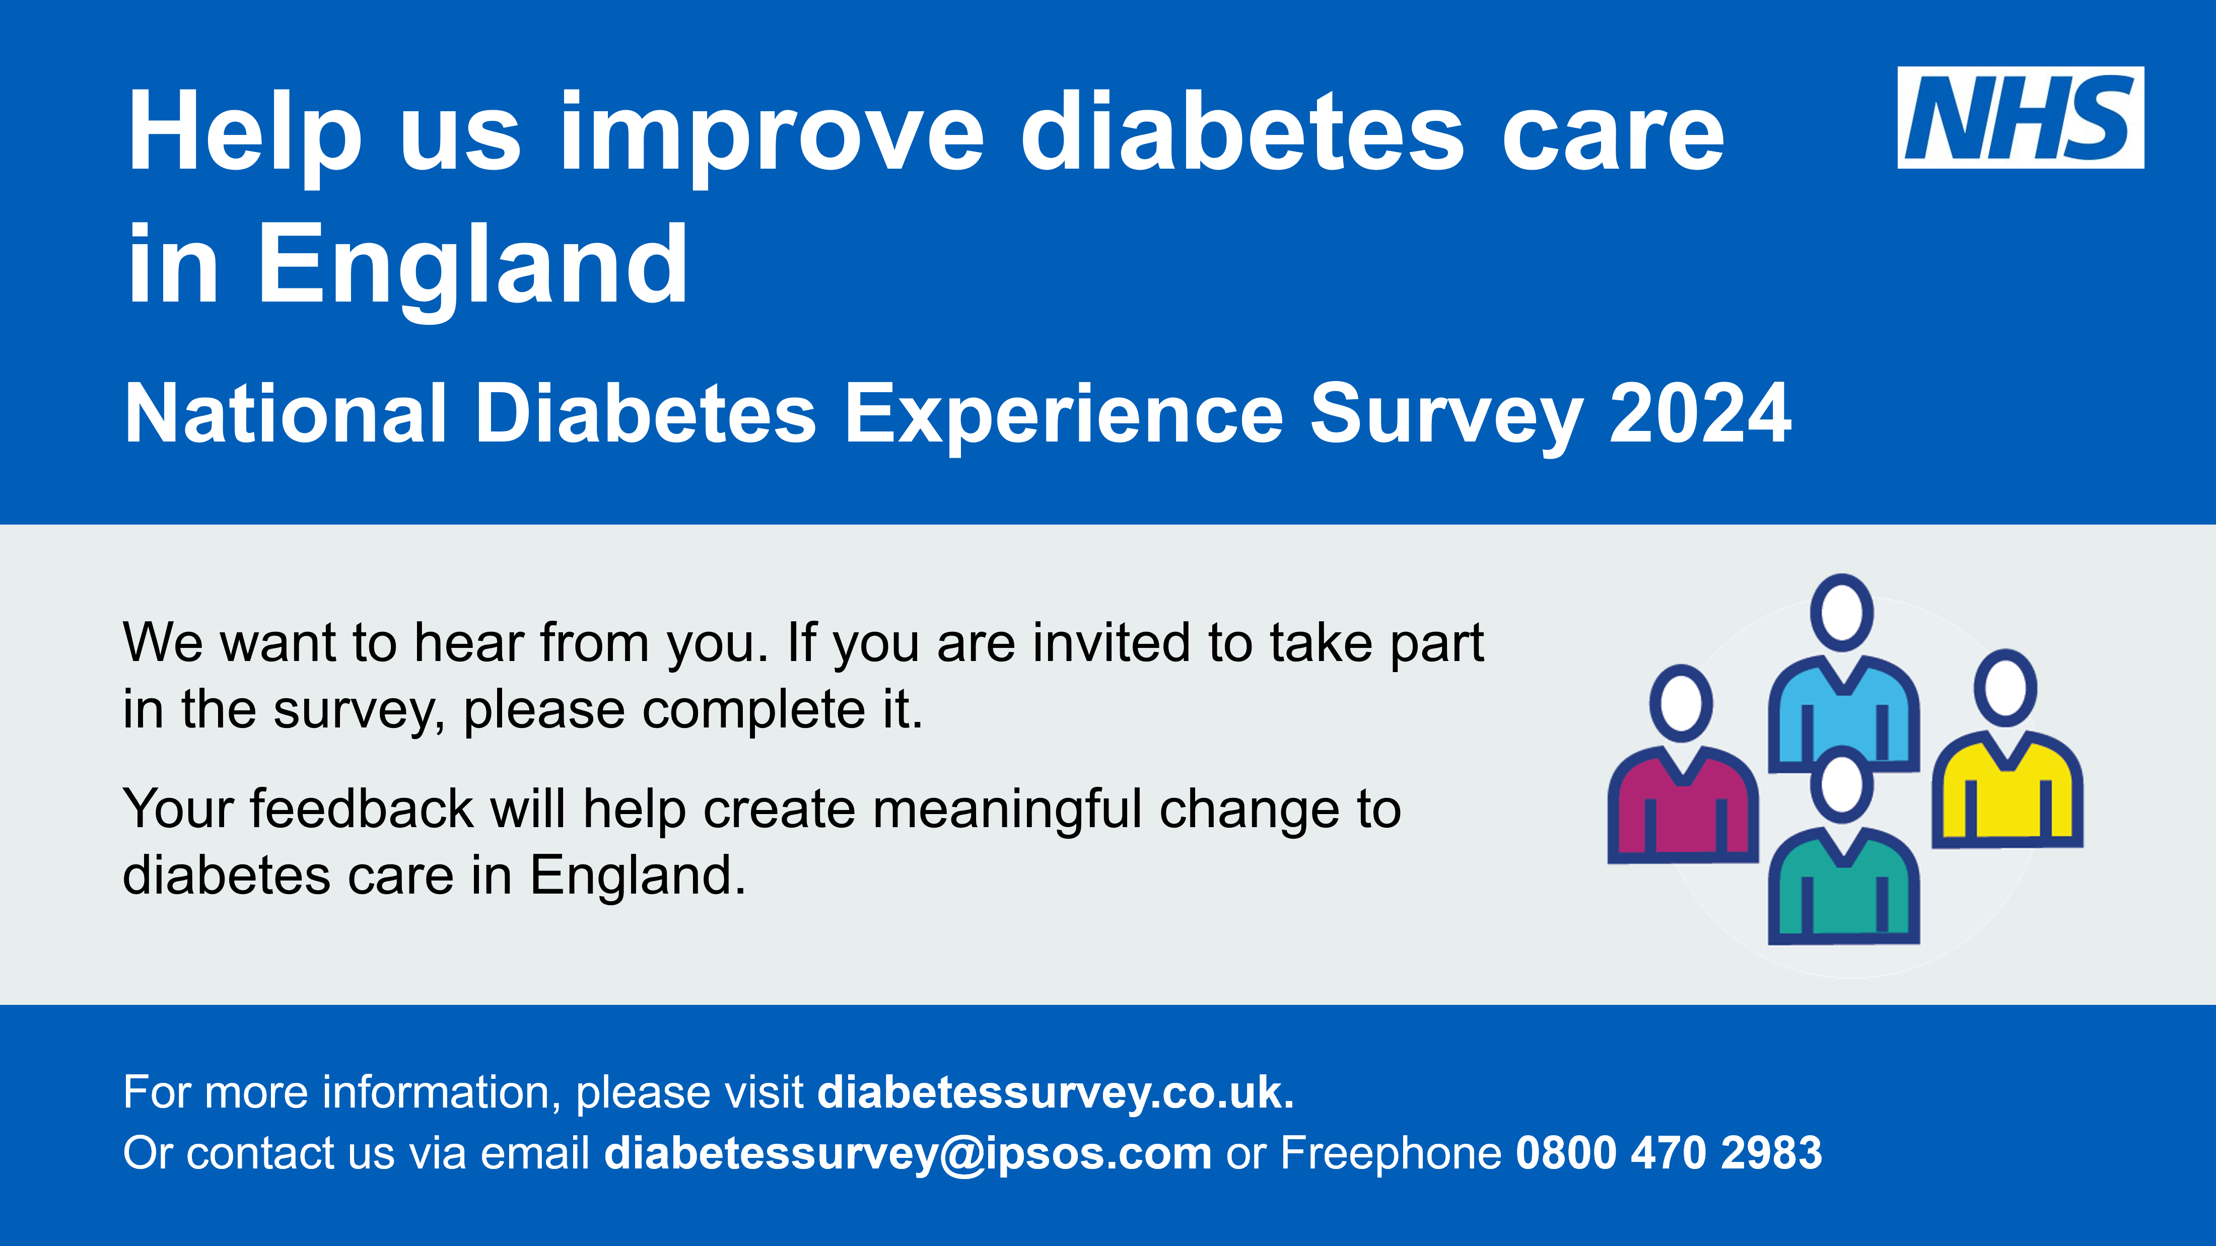
POSTER
Please consider displaying this poster in areas that are visible to people living with diabetes and their friends or family. You can also display them online, for example on your website, social media or TV screens in waiting areas.
The posters are available in both portrait and landscape format. Posters are available in 11 different languages (Arabic, Bengali, French, Gujarati, Italian, Polish, Portuguese, Punjabi, Romanian, Spanish and Urdu). Please display posters that are most appropriate for your local population.
Downloads of the promotion poster can be found at www.diabetessurvey.co.uk/promote-the-survey

Slide 8
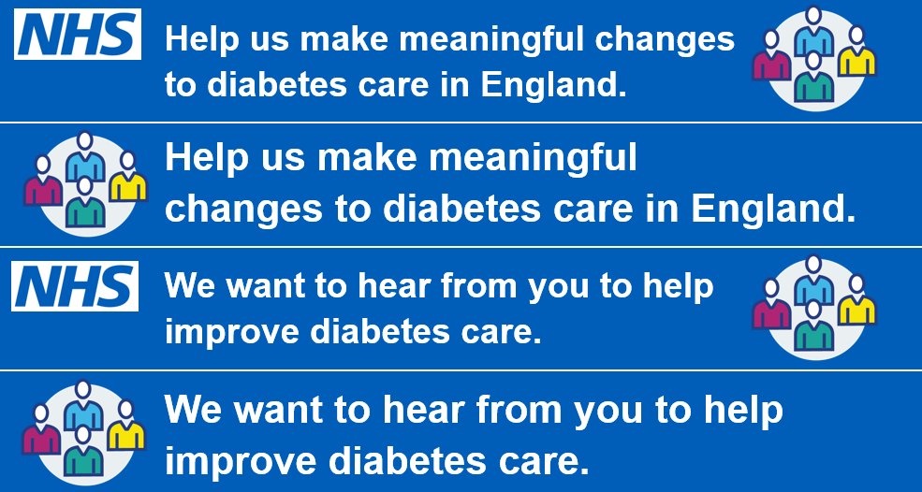
WEBSITE COPY
Please consider using the following web copy on your website alongside the web banner graphic. The web banners can be downloaded at www.diabetessurvey.co.uk/promote-the-survey.
Title – National Diabetes Experience Survey 2024
Copy
The National Diabetes Experience Survey is a new survey which gives people living with type 1 or type 2 diabetes in England the opportunity to feedback on their experiences. NHS England will use the findings to understand and improve experience of NHS care and self-management for people living with diabetes.
If you are invited, you will receive a letter with information about the survey. Please don’t miss the opportunity to take part and share your experiences of care. NHS England need as many people as possible to take part so that the results reflect the views of different people living with diabetes.
The survey takes no more than 15 minutes to complete and can be done online, on paper, or over the phone. If you need support completing the survey, you can call the free helpline number 0800 470 2983. Or email diabetessurvey@ipsos.com. For more information about accessibility and completing the survey in another language, please visit www.diabetessurvey.co.uk/accessibility-and-language.
The survey is anonymous and all personal data will be kept safe. For more information about the use and protection of data, please visit www.diabetessurvey.co.uk/confidentiality-and-data-protection.
The results of the survey will be available in Autumn 2024.
For more information about the survey and how to access help completing it, please visit www.diabetessurvey.co.uk.

Slide 9
NEWSLETTER COPY
Newsletter copy can be used in public facing newsletters or shared with partner organisations that have agreed to help raise awareness of the survey.
National Diabetes Experience Survey 2024
The National Diabetes Experience Survey is a new survey which gives people living with type 1 or type 2 diabetes in England the opportunity to feedback on their experiences. NHS England will use the findings to understand and improve experience of NHS care and self-management for people living with diabetes. The survey has also been designed to help local diabetes services make improvements based on what really matters to people living with diabetes.
From 18th March 2024, around 100,000 people living with diabetes will be randomly selected and invited to take part in the survey by letter and text message. NHS England need as many people as possible to respond to the invite so that the results reflect the views of different people living with diabetes.
If you receive an invitation, please don’t miss your opportunity to take part in the survey and share your experiences. If you need support completing the survey or need it made available in another language, you can call the free helpline number 0800 470 2983, email diabetessurvey@ipsos.com or visit www.diabetessurvey.co.uk/accessibility-and-language.
This is the first time the survey has been run. Until now, there has not been a national survey of this scale for people living with diabetes in England. This is an exciting new opportunity to help diabetes services make improvements based on what really matters to people.
NHS England have collaborated closely with people living with type 1 and type 2 diabetes, carers of those living with diabetes, healthcare professionals, and local providers to develop this survey. This collaboration ensures that the survey remains relevant, accessible, and impactful for people living with diabetes.
For more information on how we accessed and use data, please visit www.diabetessurvey.co.uk/confidentiality-and-data-protection.
For more information about the survey and other ways to provide feedback on diabetes care, please visit www.diabetessurvey.co.uk.

Slide 10
BLOG COPY
This content has been developed for use on webpages and can be adapted for your local audience with inclusion of local case studies. The content has been written to be suitable for both the NHS as well as other organisations and charities to use.
The National Diabetes Experience Survey is inviting over 100,000 adults living with type 1 or type 2 diabetes in England to take part in the survey this year to feed back on their experiences of care. If you are invited, please don’t miss the opportunity to make your voice heard.
NHS England developed this important new survey together with people living with type 1 and type 2 diabetes, carers of those living with diabetes, healthcare professionals, and local providers. Together, they form the survey Advisory Group. Below are some quotes explaining why this survey is important to them.
[WHEN DRAFTING BLOG, PLEASE INSERT ADVISORY GROUP QUOTES AS REQUIRED USING THE CONTENT ON SLIDES 11 AND 12].
For more information, please visit www.diabetessurvey.co.uk/meet-the-survey-team.
The survey will provide an opportunity to harness user voices into the development of policy and practice. NHS England are looking to understand experiences to support the development of a more person-centred policy for delivering healthcare services for people with diabetes. The survey has also been designed to help local diabetes services make improvements based on what really matters to people living with diabetes.
If you are invited, you will receive a letter with information about the survey. Please don’t miss the opportunity to fill out the questionnaire and have your say. We need as many people as possible to take part so that the results reflect the views of different people living with diabetes. Whoever you are, whichever services you access, and whatever your experience of living with diabetes, your opinion is important.
If you need support completing the survey or need it made available in another language, you can call the free helpline number 0800 470 2983, email diabetessurvey@ipsos.com, or visit www.diabetessurvey.co.uk/accessibility-and-language.
For more information on the survey please visit www.diabetessurvey.co.uk.

Slide 11
ADVISORY GROUP QUOTES
If using the Advisory Group quotes, please do not change the wording.
Text that can be used on the importance of codesign:
Codesign with people living with diabetes has been vital in developing the National Diabetes Experience Survey, focusing on what matters most to people with lived experience.
NHS England has collaborated with lived experience partners, people living with diabetes who are part of the survey advisory group, throughout the development of the survey. This codesign has resulted in:
A methodology which focuses on inclusivity.
A website which is accessible and meets user needs.
Invitation letters and communications materials which are engaging, persuasive and understandable.
A questionnaire which is accessible, uses appropriate language, and asks about topics which are important to people living with diabetes.
Advisory Group quotes:
“I strongly believe that all people living with diabetes should be given the right support to live a long and healthy life. But we know that there are inequalities in healthcare outcomes and experiences. This survey is our bridge to understanding the “why”. It will give people living with diabetes the chance to have their voice heard. The survey results will help us to understand the barriers that people face. This means that I, and other clinicians, can better support and communicate with people living with diabetes in the future.”
Dr Sophie Harris, Chair of the Advisory Group, Diabetes Clinical Lead and Consultant
“Understanding what matters to people with lived experience of diabetes is an important factor in shaping our services and better supporting people to live well with the condition. The survey is an opportunity for you to be heard and for us to take action, so please do get involved.”
Corinne Robinson, NHS Gloucestershire Diabetes Senior Programme Manager
“We are healthcare professionals working in both GP practices and hospitals, and some of us also have personal experience of living with diabetes. Gathering feedback on care is a top priority for us, and this survey is an amazing opportunity to hear from many difference voices. If you’ve been invited, we’d really appreciate you taking the time to take part in the survey. Your feedback will be vital in helping us understand what works well with diabetes care and what needs to be improved.”
Amanda Epps, Lead Nurse for Diabetes and Endocrinology
Dr Rebecca Haines, GP
Dr Alistair Lumb, Diabetes Consultant

Slide 12
ADVISORY GROUP QUOTES
If using the Advisory Group quotes, please do not change the wording.
“As people living with diabetes, we have had significant input into how this survey has been put together. Our voices have helped to make this survey a relevant and important turning point in the improvement of care and support for everyone living with diabetes. By filling in the survey, your input will be added to our voices. Everyone involved in the provision of care for those living with diabetes will hear us loud and clear and know exactly where change is needed to provide the best possible diabetes care and support in our journeys through the NHS.” Andrew, on behalf of the partner team
“I joined this lived experience group as a carer of someone living with diabetes, to give my input to the questionnaire and bring experiences of the black and South Asian community to this survey. I am hoping this survey will put the patients’ voice at the heart of patient care for individuals with diabetes.” Ajanta
“I live with type 2 diabetes, and my initial experience and ongoing support fell short, but participating in an NHS diabetes services survey has been a valuable chance to contribute. Despite challenges, it highlights the NHS's commitment to improvement and offers individuals like me an opportunity to make a positive impact in diabetes care, maybe you could too by taking part in the survey.” Annetta
“I am 52 years old and was diagnosed with type 1 diabetes at the age of 13. Diabetes care has progressed during this time but there are still opportunities through enhanced healthcare to improve the quality of life for people living with the condition. My role in the Advisory Group enables my voice to be heard and helps to retain focus on the lived experience and what good support means to us.” Becky
“l am living with type 2 diabetes, a few years after I developed gestational diabetes. I have dedicated the last 18 months to a diabetes Advisory Group, together with other people living with type 1 and type 2 diabetes to develop a National Diabetes Experience Survey. I joined this group to ensure that people living with diabetes would be fully supported and receive guidance from clinicians, and for clinicians to be aware of the concerns they may have.” Carmen
“I've been living with type 1 diabetes for over 27 years. I am a member of the Advisory Group because I believe it is important for everyone living with diabetes to share their experiences on diabetes care so that our voices are heard, great care is celebrated and where improvements are needed our voices are shaping these.” Dan
“I’ve had good experiences of care since being diagnosed with type 2 diabetes at my local doctor’s surgery, but I know that other people haven’t had such a good experience. It feels great to be a part of this programme and contribute towards this survey, to help everyone living with diabetes have better outcomes.” Paul

Slide 13
SOCIAL MEDIA CONTENT
Over the following pages you will find suggested copy for:
X (Twitter) and Instagram
LinkedIn
Facebook
Please always tag @NHSEngland and @NHSDiabetesProg and when relevant for the channel use the hashtag #NationalDiabetesExperienceSurvey.
Alongside the wording provided, you can share images provided in this toolkit (for example, the poster or website banner), retweet NHS England social media posts with images, or use your own images.
We recommend that you do not change the wording of the social media posts.

Slide 14
X (Twitter) / INSTAGRAM
We have included some emojis below in the posts. Please make use of these where relevant and suitable. For Instagram posts, you can use this text with suitable media (for example, the poster or website banner included in this toolkit).
Posts for the beginning of the fieldwork period (March 2024):
New opportunity to make meaningful change to diabetes care in England 📢 The National Diabetes Experience Survey is coming soon to over 100,000 people living with diabetes in England. If you are invited to take part, have your say online or by post 💌
Help us understand your experience of living with diabetes. Between March and May, we will ask over 100,000 people living with diabetes in England about their care and treatment. What you tell us will shape future services. Find out more at www.diabetessurvey.co.uk
Be one of the first to tell us about your experience of living with diabetes 📢 The National Diabetes Experience Survey is the first of its kind. If you are selected, have your say on the future of diabetes care in England. Find out more at www.diabetessurvey.co.uk
Received a questionnaire? We want to hear from you! 📢 We are sending out the National Diabetes Experience Survey to over 100,000 people living with diabetes in England. Find out more about the survey and how to take part at www.diabetessurvey.co.uk
Posts to remind people to take part at the end of the fieldwork period (May 2024):
Don't miss your chance to make meaningful change to diabetes care ⏰ Since March, the National Diabetes Experience Survey has been sent to over 100,000 people living with diabetes in England. If you've been invited, have your say. Find out more at www.diabetessurvey.co.uk
Encourage people who have not been selected to promote the survey:
The NHS needs your help to understand what it's like living with diabetes in England today 🤝 Everyone's voice matters. If you have not been selected for our diabetes survey, please encourage those invited to take part by sharing why it's important to you www.diabetessurvey.co.uk

Slide 15
LinkedIn
Be one of the first to have your say about living with diabetes by taking part in NHS England's new diabetes survey. From March 2024, around 100,000 people living with diabetes in England will be asked to take part in the National Diabetes Experience Survey. If you’re invited, take part to tell us what it's like living with diabetes today. The findings will be used to understand and improve experiences of self-management and NHS care for people living with diabetes. If you need support completing the survey or want to take part in another language or format, visit www.diabetessurvey.co.uk/accessibility-and-language. Or you can contact us via email at diabetessurvey@ipsos.com or call the free helpline number on 0800 470 2983.
Don't miss this chance to make your voice heard in NHS England's new diabetes survey. Understanding experiences of care for people living with diabetes is extremely important as it helps us adapt our services to best suit your needs. If you are invited to the National Diabetes Experience Survey, please take part and help shape NHS services. Invitations to take part in the survey will be posted to those who have been selected. For more information on the survey and how to access help and support in completing it please visit www.diabetessurvey.co.uk/accessibility-and-language. Or you can contact us via email at diabetessurvey@ipsos.com or call the free helpline number on 0800 470 2983.

Slide 16
FACEBOOK
We have included some emojis below in the posts. Please make use of these where relevant and suitable.
Are you living with diabetes in England? We want to hear from you 📢 From March 2024, around 100,000 people living with diabetes in England will be asked to take part in the National Diabetes Experience Survey. If you receive an invitation, please take part in the survey to help us understand what it is like living with diabetes today. What you say will improve experiences of self-management and NHS care. If you need support completing the survey or want to take part in another language or format, please visit www.diabetessurvey.co.uk/accessibility-and-language. Or you can contact us via email at diabetessurvey@ipsos.com or call the free helpline number on 0800 470 2983.
A new opportunity is coming to help shape diabetes care in England. If you are among the 100,000 people asked to take part in the National Diabetes Experience Survey, make sure your voice is heard by responding online or by post 💌 Invitations to take part in the survey will be posted to selected people living with diabetes in England. If you need support completing the survey or want to take part in another language or format, please visit www.diabetessurvey.co.uk/accessibility-and-language. Or you can contact us via email at diabetessurvey@ipsos.com or call the free helpline number on 0800 470 2983.

Slide 17
NHS ENGLAND BLOG
NHS England will be publishing a blog, written by the National Clinical Director of Diabetes and Obesity for NHS England, Clare Hambling.
The blog will be available on the NHS England website once fieldwork begins: https://www.england.nhs.uk/blogs/
You can use this blog to publicise the survey. For example, by sharing it on social media or other forums.

Slide 18
VIDEOS
NHS England have produced videos with some members of the National Diabetes Experience Survey Advisory Group.
These are short clips (less than 30 seconds) with members of the Advisory Group talking about the survey and why it’s important to take part.
These videos will be shared from the @NHSDiabetesProg X account throughout fieldwork, please do retweet these if you can. The video files are also available on request from england.digitaldiabetes@nhs.net for use on your own social media.

Slide 19






ICONS
These icons can be used when promoting and communicating about the National Diabetes Experience Survey to aid understanding. These can be downloaded at www.diabetessurvey.co.uk/promote-the-survey.
Promote the survey/Have your say
Taking part
Taking part/Impact change
Take part by post
Analysis of results
Accessibility

Slide 20
FAQs
Q. What is the National Diabetes Experience survey?
A. The National Diabetes Experience Survey is a new survey which gives people living with type 1 or type 2 diabetes in England the opportunity to feedback on their experiences.
NHS England will use the findings to understand and improve experiences of NHS care and self-management for people living with diabetes.
Q. Who is running the survey?
A. NHS England is responsible for delivering the National Diabetes Experience Survey. NHS England leads the National Health Service (NHS) in England. You can find out more on the NHS website.
NHS England is working with Ipsos, an independent research organisation, to deliver this survey. Ipsos strictly adheres to the Market Research Society's Code of Conduct. You can find out more on the Ipsos website.
Q. How can I find out more about the survey?
A. You can find more information about the survey at https://diabetessurvey.co.uk
Q. When will survey results be available?
A. Results will be available in Autumn 2024 at https://diabetessurvey.co.uk
Q. Who has received a survey?
A. Over 100,000 adults, aged 18 and over, living with type 1 or type 2 diabetes in England have been selected to take part in the National Diabetes Experience Survey this year.
People have been invited to take part because their name was chosen at random from an NHS list of people living with diabetes. This is called the National Diabetes Audit (NDA). NHS England matched names with contact details from the list of patients registered with a GP, called the Personal Demographic Service (PDS). NHS England has shared a limited amount of personal data so that Ipsos can invite people to take part in this research.
For more information about protection of data, please visit https://diabetessurvey.co.uk/confidentiality-and-data-protection

Slide 21
FAQs
Q. I have received a questionnaire but need help completing it
A. You can call our free helpline number 0800 470 2983, between 10am and 4pm Monday to Saturday, to take part over the phone. You can also request a copy of the questionnaire in large print or in Braille, take part using our Text Relay service or in another language. For more information on the survey and how to access help and support in completing it please visit www.diabetessurvey.co.uk/accessibility-and-language.
Q. Can someone help me to take part in the survey?
A: If you would like someone to help you take part the survey it’s fine to ask a friend or relative to help, but please make sure the answers are only about your experiences. Ipsos also provides a Freephone survey helpline for people who need help to take part. Please call 0800 470 2983 between 10am and 4pm Monday to Saturday.
Q. I want to take part but you haven’t sent me a survey.
A. Thank you for your interest in the National Diabetes Experience Survey. People selected to take part in the survey were chosen at random from a list of people living with diabetes. To be eligible for the survey, you need to be living with type 1 or type 2 diabetes, at least 18 years old, and diagnosed at least 12 months ago. To ensure that the results are robust and representative, unfortunately we will not be able to send you a questionnaire if you have not been randomly selected to take part.
However, NHS England are committed to hearing patient’s views on services they have received, and there are other ways you can provide feedback. For example, you can also give feedback on services by posting comments on websites including the NHS website.
If you want to complain about the service or care you have received, you can choose whether to complain directly to the healthcare provider (for example your hospital or GP practice), or to the commissioner (which is the organisation that pays for the service or care you received).
The commissioner is your local Integrated Care Board (ICB) if your complaint is about:
primary care services such as GPs, dentists, opticians or pharmacy services
hospital care, mental health services, out of hours services, NHS 111 and community services such as district nursing
If you choose to complain to your local ICB, you can find out how to contact them on this website:
NHS England » Contact your local integrated care board (ICB)
Very often the healthcare provider will be able to resolve the matter for you locally.
More information about making a complaint can be found on the following website:
NHS England » Feedback and complaints about NHS services.

Slide 22
FAQs
Q. Do I have to take part?
A. Taking part in the survey is voluntary. We hope you will take part as this will give us the best possible picture of people’s experience of living with diabetes in England. But if you choose not to take part, it will not affect your care and you don’t need to give us a reason.
Q. How will data be held and processed?
A: Personal data are held in accordance with the UK General Data Protection Regulation and Data Protection Act 2018. If you are invited to take part, NHS England’s Privacy Notice describes how they will use personal data and explains how you can contact them and invoke your rights as a data subject. NHS England will protect your information in line with the requirements of the Data Protection Act 2018.
Q: How will Ipsos keep data secure? What information can you provide about GDPR?
A: Ipsos takes its information security responsibilities seriously and applies various precautions to ensure information is protected from loss, theft, or misuse. Security precautions include appropriate physical security of offices and controlled and limited access to computer systems. Stringent measures have been taken to ensure personal information is securely stored and seen only by the personnel directly involved in the project.
Ipsos has regular internal and external audits of its information security controls and working practices and is accredited to the International Standard for Information Security, ISO 27001.
Individual answers to the questions will not be linked to names or contact details. Ipsos, and approved NHS England staff and researchers, treat individual answers as confidential. They adhere to all aspects and terms of the UK General Data Protection Regulation and all other relevant legislation, including requirements for secure storage.
For more information about protection of data, please visit https://diabetessurvey.co.uk/confidentiality-and-data-protection

Slide 23
FAQs
Q. What are my GDPR rights?
A:The UK GDPR includes rights, although not all of these apply where the legal basis for processing is necessary for public health purposes in the public interest (UK GDPR Article 9(2)(h)).
You can request access to any personal data that is held by Ipsos up to when it is deleted (2 months after publication, estimated deletion date of January 2025).
You can object to the processing of your personal data or survey answers you provide, at any time before the data is processed for reporting (estimated date of summer 2024). You can object to the linkage of your survey responses with the National Diabetes Audit and other healthcare databases, at any time before survey data is shared with NHS England (estimated date of November 2024).
NHS England must generally respond to requests in relation to your rights within one month, although there are some exceptions to this. NHS England’s Privacy Notice explains your rights and how to exercise them.
You have the right to lodge a complaint with the Information Commissioner’s Office (ICO) if you have concerns on how we have processed your personal data. You can find details about how to contact the Information Commissioner’s Office at https://ico.org.uk/global/contact-us/ or by sending an email to: casework@ico.org.uk.

Slide 24
THANK YOU
For any questions, please contact:
NHS England: england.digitaldiabetes@nhs.net
Ipsos: diabetessurvey@ipsos.com

